Slide 1
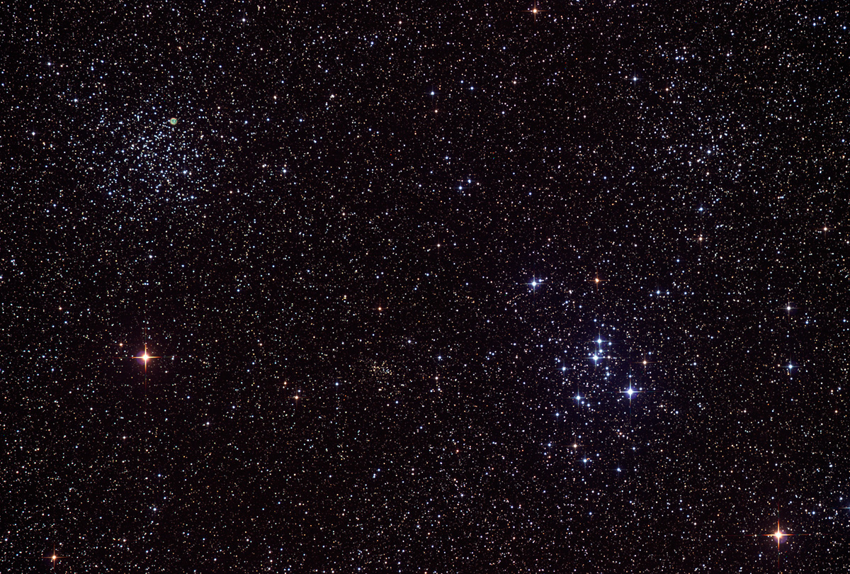
Astronomical League
“Umbrella” organization composed of over 240 member astronomy clubs
Mission is to foster astronomy education and to encourage interest in astronomy
Promote and coordinate activities of amateur astronomers through the establishment of observing programs

Slide 2
Beginner Observing Clubs
Analemma Program Asterism Program
Binocular Double Star Program Bright Nebula Program
Binocular Messier Program Carbon Star Program
Constellation Hunter Program Comet Observers Program
Dark Nebula Program Dark Sky Advocate Program
Deep Sky Binocular Program Double Star Program
Galileo Program H-Alpha Solar Program
Lunar Program Messier Program
Meteor Program Occultation Program
Sky Puppy Program Stellar Evolution Program
Southern Skies Binocular program Variable Star Program
Universe Sampler Program

Slide 3
Intermediate Observing Clubs
Asteroid Observing Program
Caldwell Program
Earth Orbiting Satellite Program
Globular Cluster Program
Herschel 400 Program
Lunar II Program
NEO Award
Outreach Award
Solar System Observers Program
Sunspotters Program
Southern Sky Telescopic Program
Urban Observing Program

Slide 4
Advanced Observing Clubs
Arp Peculiar Galaxy Program
Flat Galaxies Program
Galaxy Groups and Clusters Program
Herschel II Program
Local Galaxy Groups and Neighborhood Program
Master Observer Award
Open Cluster Program
Planetary Nebula Program

Slide 5
General Requirements
Download Observing List or purchase Observing Guide
Download (or create) Reporting Form
General information – ID, date, time, location
Instrument information – type, size, eyepiece, magnification, FOV
Sky conditions – transparency and seeing
Description
Drawing (or picture)
Miscellaneous – OC classification, Sunspot classification, Dark Nebula opacity, etc.

Slide 6
Messier Observing Program
Observe 70 Messier objects
Date, time
Seeing conditions
Aperture of telescope
Magnification
Description
Have records reviewed by a HAL officer or ALCOR. Officer will send letter to AL Messier Club coordinator who sends certificate to HAL for presentation
If the rest of the objects are observed, officer or ALCOR reviews observations and sends letter to AL and awardee receives Honorary Certificate and pin
No device aided observations are acceptable. Only finderscope, Telrad, or similar finders accepted.

Slide 7
Lunar Club
Observe 100 lunar features off list provided
18 naked eye
46 binocular
36 telescopic
List instruments used
Check off features observed; give date and time
Provide information to ALCOR or to AL coordinator

Slide 8
Solar System Observers Club
Complete 25 out of possible 34 projects
9 Solar and Lunar
10 Inner Solar System (includes comets and asteroids)
15 Outer Solar System
Maintain log of all required observations
Submit results to AL Club Coordinator

Slide 9
Urban Observing Club
Observe 100 objects from list in light polluted skies
85 Deep Sky
15 Double & Variable Stars
Maintain required log (drawings not required)
Submit results to AL Club Coordinator

Slide 10
Arp Peculiar Galaxy Program
Observe or image any100 Arp galaxies of your choosing ( 338 possible)
Maintain appropriate log (drawings not required)
Submit results to AL club coordinator

Slide 11
For More Information
www.astroleague.org

